Slide 1


Stopping Counterfeit Product and
Connecting with your Customers
Solution Overview for
The Premium Beverage Industry
May 2021

Slide 2



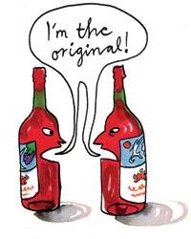

No one is safe from Counterfeit Wine

Slide 3
The traditional label doesn’t
offer enough protection

Slide 4

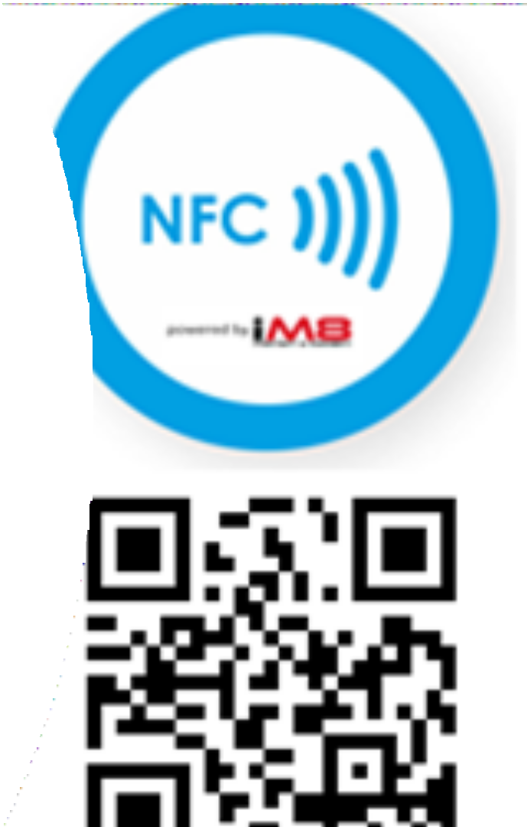
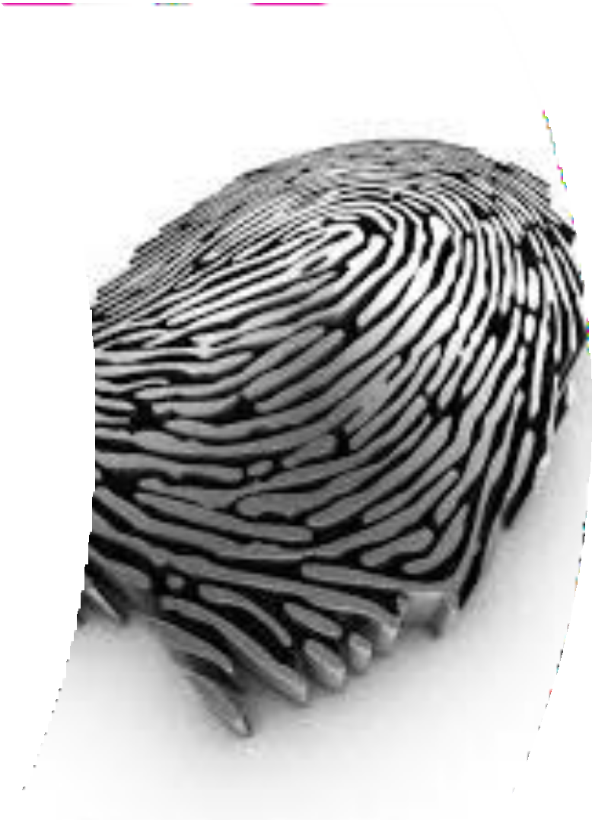
The iM8 Digital Tag gives every bottle its own unique traceable fingerprint

Slide 5

iM8 QR Codes can be digitally printed on the existing wine labels and/or
an iM8 NFC chip can be affixed directly to the bottle

Slide 6
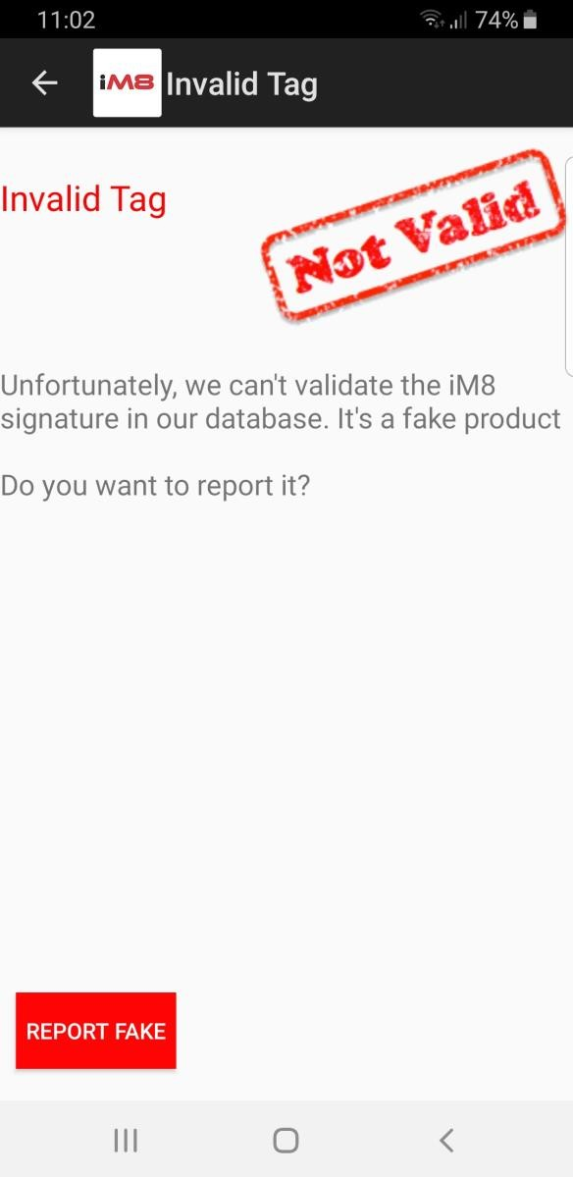
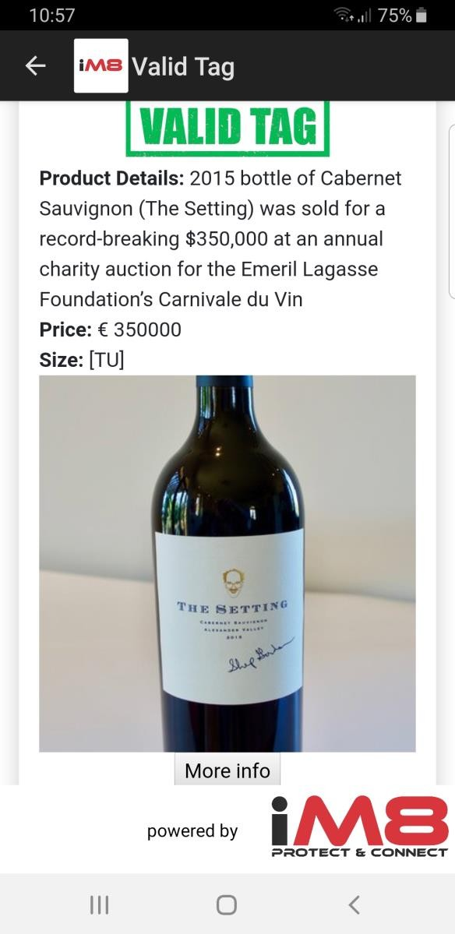

Blockchain Product Protection
All the consumer has to do is to scan the iM8 QR code or NFC chip with their phone
The iM8 app will tell them immediately if the product is genuine or counterfeit

Slide 7
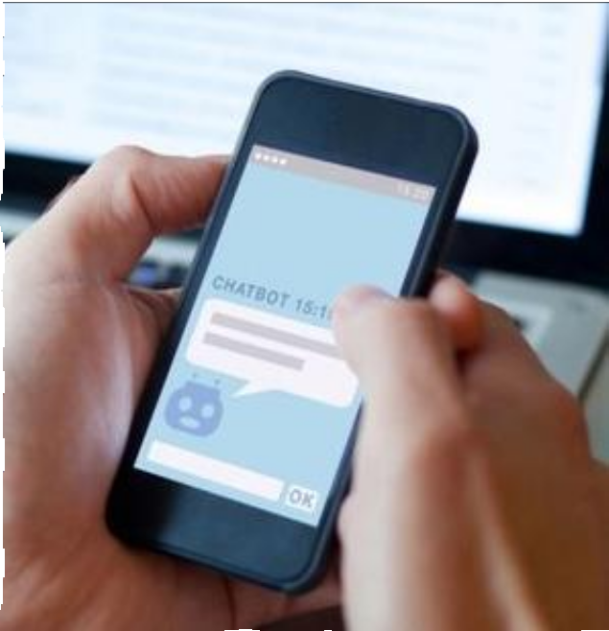
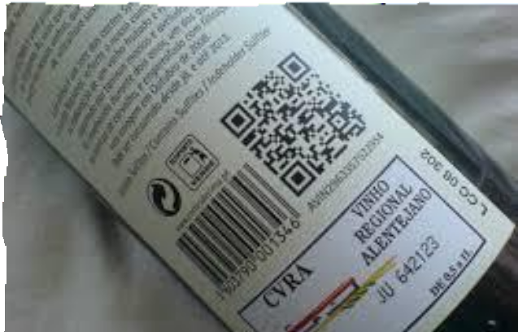
Connect with your Customers
Each bottle is individually identifiable by scanning the iM8
Digital Tag
Customer scans the Tag and iM8 opens up a direct communications channel with the customer
Channels include:
Company webpage
Interactive bot
Online shop
Messaging platform (Facebook, Snapchat etc.)
Brand app
Loyalty programme

